Slide 1
Planning in Continuous Spaces: Motion Planning
Tom Silver
Robot Planning Meets Machine Learning
Princeton University
Fall 2025

Slide 2
Recap and Preview
Earlier:
Planning in finite “tabular” state and action spaces
Careful treatment of uncertainty in transitions and observations
Offline planning and online planning
Last Time:
Planning in finite “factored” state and action spaces
No more uncertainty
Online planning only
This Time:
Planning in continuous spaces
But with a very specific structure

Slide 3
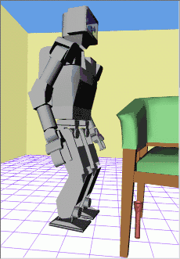
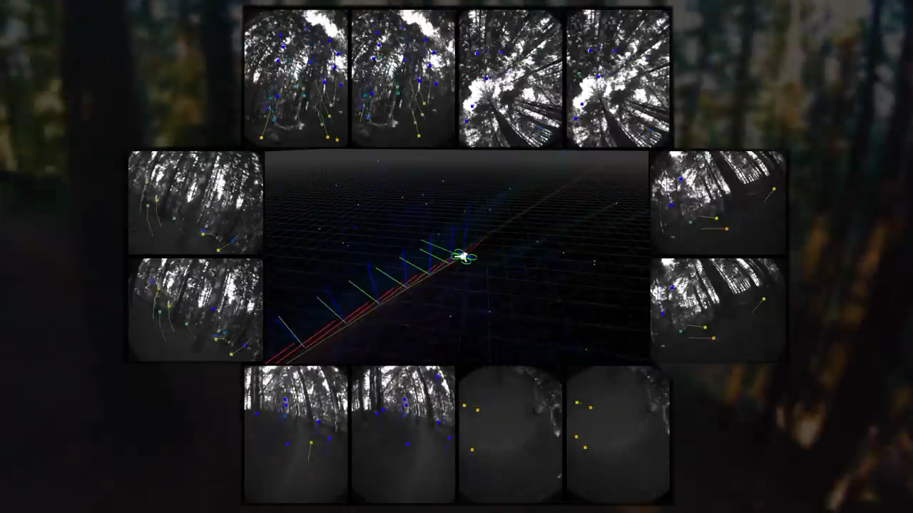
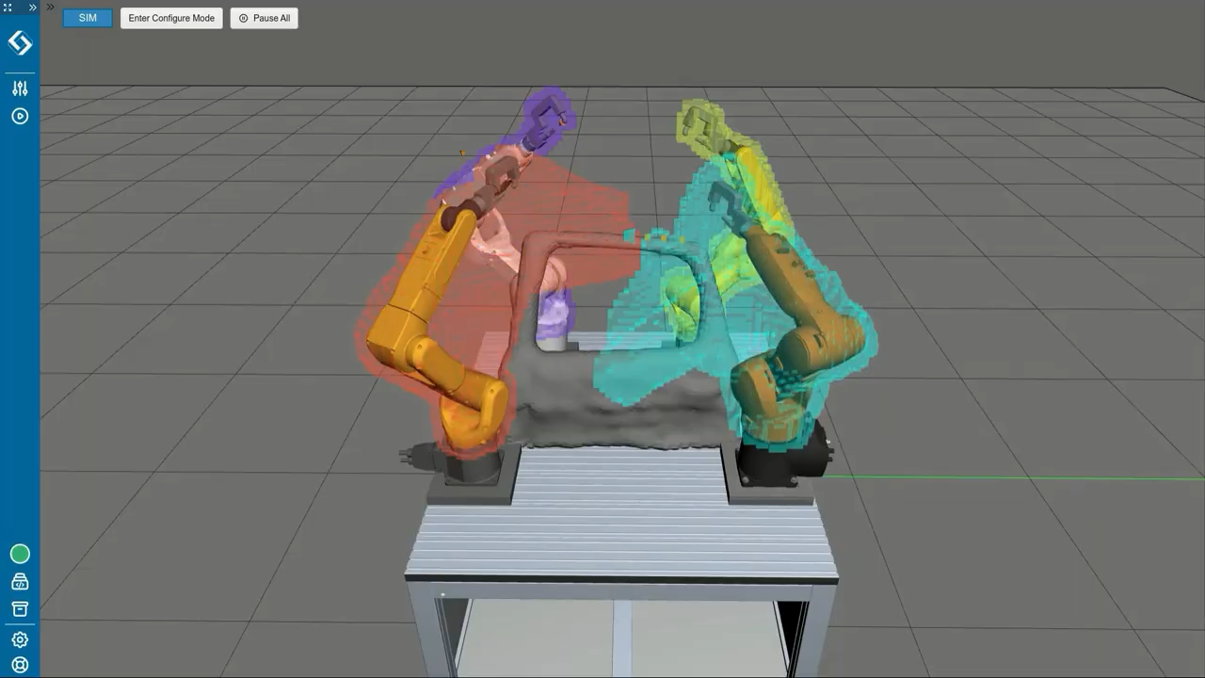
Motion Planning
Kuffner (2002)
Skydio (2019)
Realtime Robotics (2023)

Slide 4
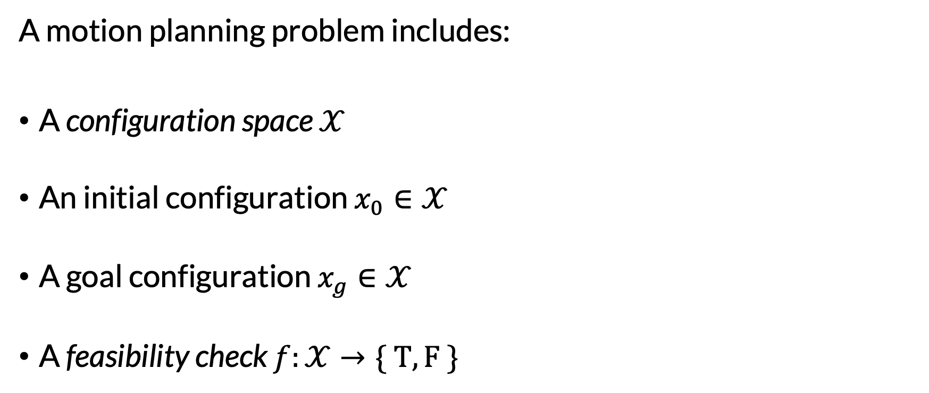
Motion Planning Problem Setting
A motion planning problem includes:
A configuration space $𝒳$
An initial configuration $x_{0}∈𝒳$
A goal configuration $x_{g}∈𝒳$
A feasibility check $f:𝒳→\{ T, F \}$
Must be bounded & have distance metric & have other nice properties…
Alternative definition: set of configurations
Usually: feasible (T) if robot not in collision

Slide 5
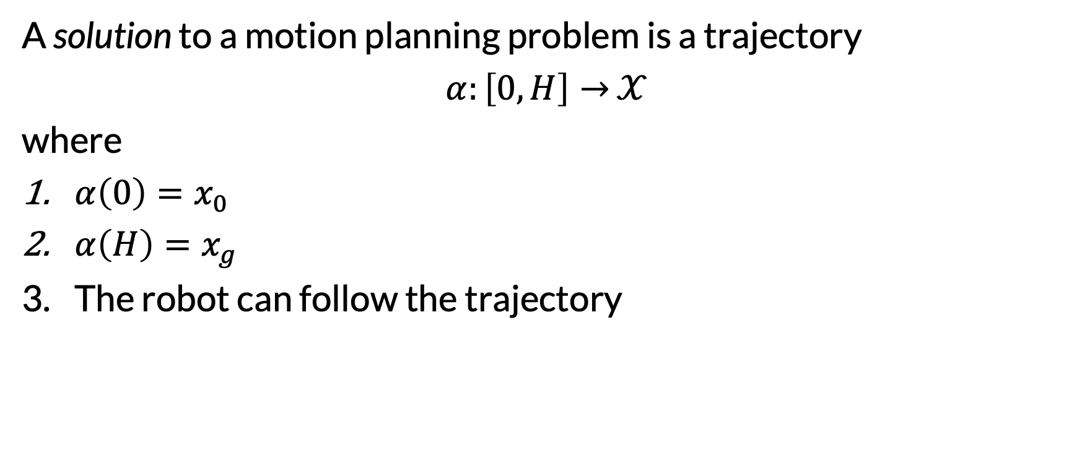
Motion Planning Solution
A solution to a motion planning problem is a trajectory
$α:\left[0, H\right]→$ $𝒳$
where
$α\left(0\right)=x_{0}$
$α\left(H\right)=x_{g}$
The robot can follow the trajectory
Continuous states and continuous time!
Many different ways to specify this
Actions are now implicit

Slide 6
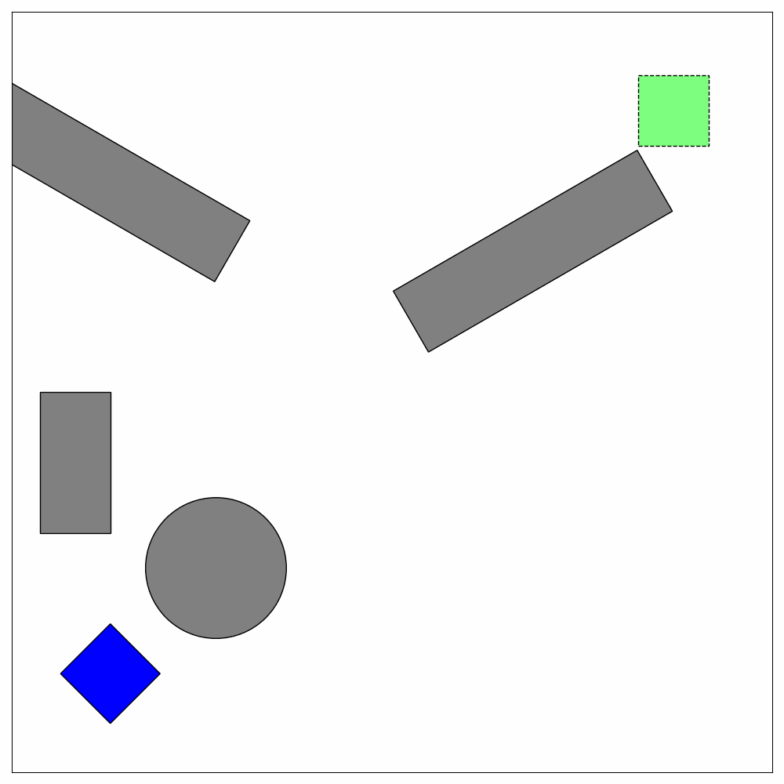
Example: Motion Planning with 2D Shapes
Configuration space:
(x position, y position, rotation)
x and y position are bounded
Subset of SE(2)
Initial configuration: see image
Goal configuration: see image
Feasibility check:
Configuration is feasible if robot is not in collision with obstacles

Slide 7
A Stupidest Possible Algorithm
Discretize the configuration space
Run path planning (e.g., A* with distance-to-goal heuristic)
When will this go badly?
Is this sound, complete, optimal?

Slide 8
A “Bug Algorithm”
At each time step:
If can move directly towards goal, do so
Otherwise, move ccw around obstacle

Slide 9
A “Bug Algorithm”
At each time step:
If can move directly towards goal, do so
Otherwise, move ccw around obstacle

Slide 10
A “Bug Algorithm”
At each time step:
If can move directly towards goal, do so
Otherwise, move ccw around obstacle

Slide 11
A “Bug Algorithm”
At each time step:
If can move directly towards goal, do so
Otherwise, move ccw around obstacle

Slide 12
A “Bug Algorithm”
At each time step:
If can move directly towards goal, do so
Otherwise, move ccw around obstacle

Slide 13
A “Bug Algorithm”
At each time step:
If can move directly towards goal, do so
Otherwise, move ccw around obstacle

Slide 14
A “Bug Algorithm”
At each time step:
If can move directly towards goal, do so
Otherwise, move ccw around obstacle

Slide 15
A “Bug Algorithm”
At each time step:
If can move directly towards goal, do so
Otherwise, move ccw around obstacle

Slide 16
A “Bug Algorithm”
At each time step:
If can move directly towards goal, do so
Otherwise, move ccw around obstacle

Slide 17
A “Bug Algorithm”
At each time step:
If can move directly towards goal, do so
Otherwise, move ccw around obstacle

Slide 18
A “Bug Algorithm”
At each time step:
If can move directly towards goal, do so
Otherwise, move ccw around obstacle

Slide 19
A “Bug Algorithm”
At each time step:
If can move directly towards goal, do so
Otherwise, move ccw around obstacle

Slide 20
A “Bug Algorithm”
At each time step:
If can move directly towards goal, do so
Otherwise, move ccw around obstacle

Slide 21
A “Bug Algorithm”
At each time step:
If can move directly towards goal, do so
Otherwise, move ccw around obstacle

Slide 22
A “Bug Algorithm”
At each time step:
If can move directly towards goal, do so
Otherwise, move ccw around obstacle

Slide 23
A “Bug Algorithm”
At each time step:
If can move directly towards goal, do so
Otherwise, move ccw around obstacle

Slide 24
A “Bug Algorithm”
At each time step:
If can move directly towards goal, do so
Otherwise, move ccw around obstacle
Show that this algorithm is not complete
There are complete bug algorithms

Slide 25
Sampling-Based Motion Planning
Let’s assume we can sample from the configuration space

Slide 26
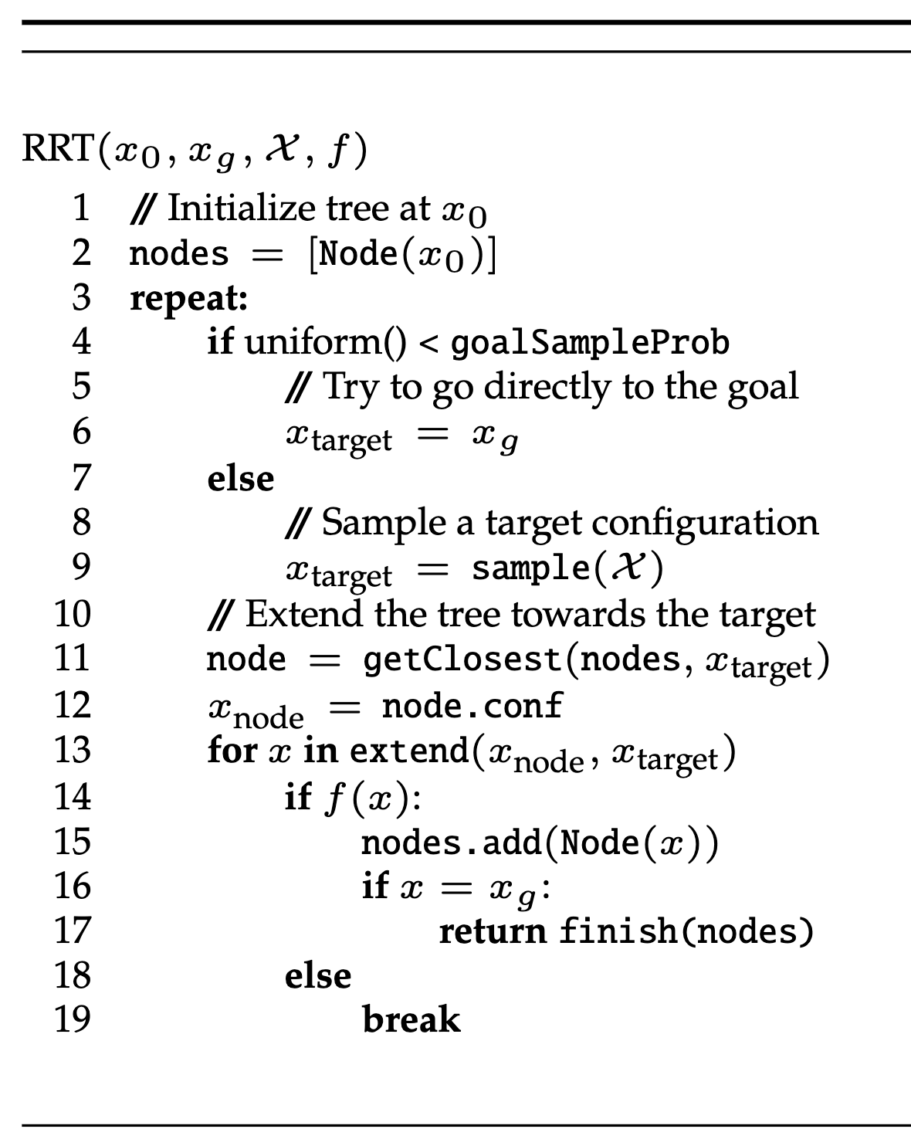
Rapidly Exploring Random Trees (RRT)

Slide 46
Many interpolation strategies are possible

Slide 47
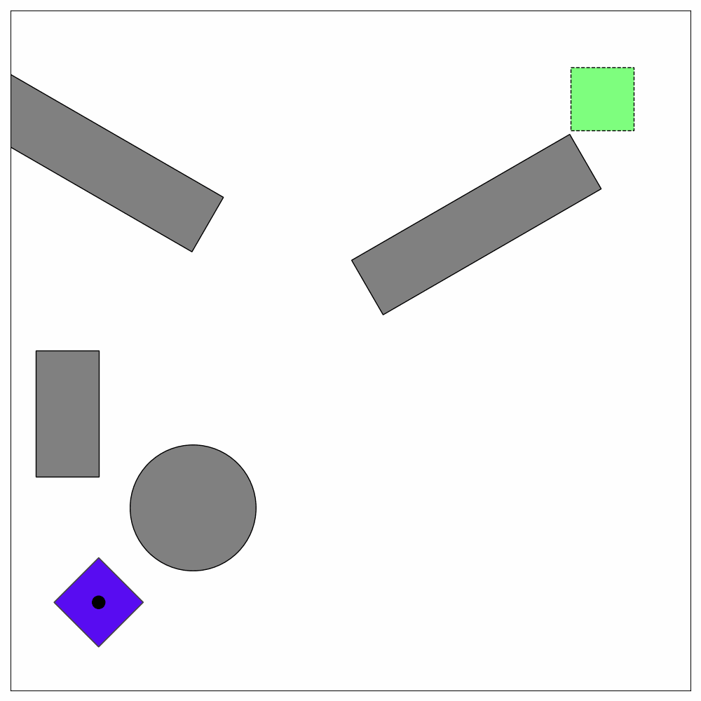

Important Hyperparameter: Feasibility Check Distance
Check Distance = 5.0
Check Distance = 1.0
Check Distance = 0.2

Slide 48
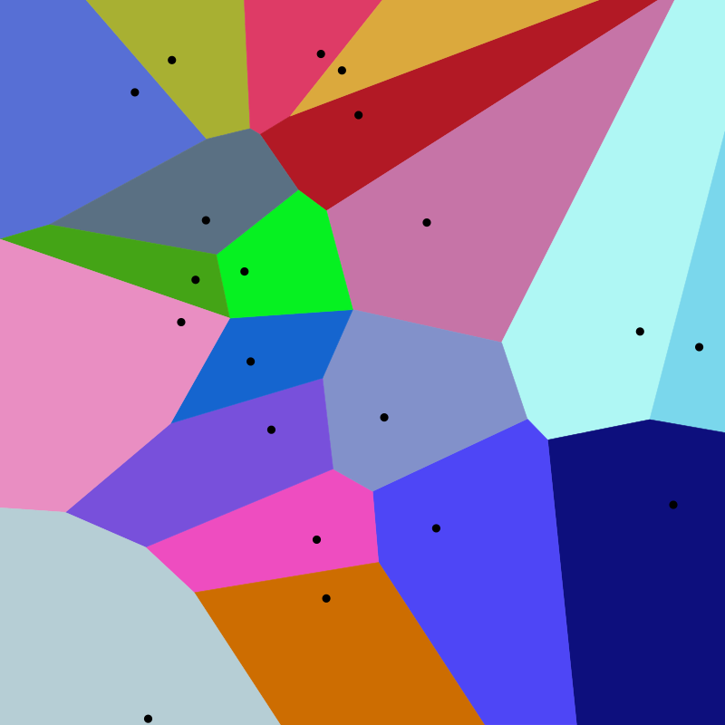
Properties of RRT
The probability of expanding a tree node is proportional to the size of its Voronoi region
Probabilistically complete
Not optimal
Single query
Works with underactuated systems
Works for kinodynamic problems
Has Voronoi bias
https://en.wikipedia.org/wiki/Voronoi_diagram

Slide 49
Post-Processing with Shortcuts
Repeatedly sample two points on the trajectory and check if a direct line between them is feasible (rewire if so)
Attempts = 0

Slide 50
Post-Processing with Shortcuts
Repeatedly sample two points on the trajectory and check if a direct line between them is feasible (rewire if so)
Attempts = 0
Attempts = 100

Slide 51
Post-Processing with Shortcuts
Repeatedly sample two points on the trajectory and check if a direct line between them is feasible (rewire if so)
Attempts = 0
Attempts = 100
Attempts = 10000

Slide 52
Bidirectional RRT
Does not work for underactuated systems
Grow two trees: one from start, the other from goal

Slide 53
Demo with 7DOF Robot Arm
https://github.com/rpmml/rpmml-code/blob/mp-pybullet-example/scripts/motion_planning_robot_example.py

Slide 54
Multi-Query Motion Planning
RRT grows tree once, from initial to goal
After the robot moves, need to start from scratch
Can we build a representation once, up front, instead?
Need a graph instead of a tree

Slide 55
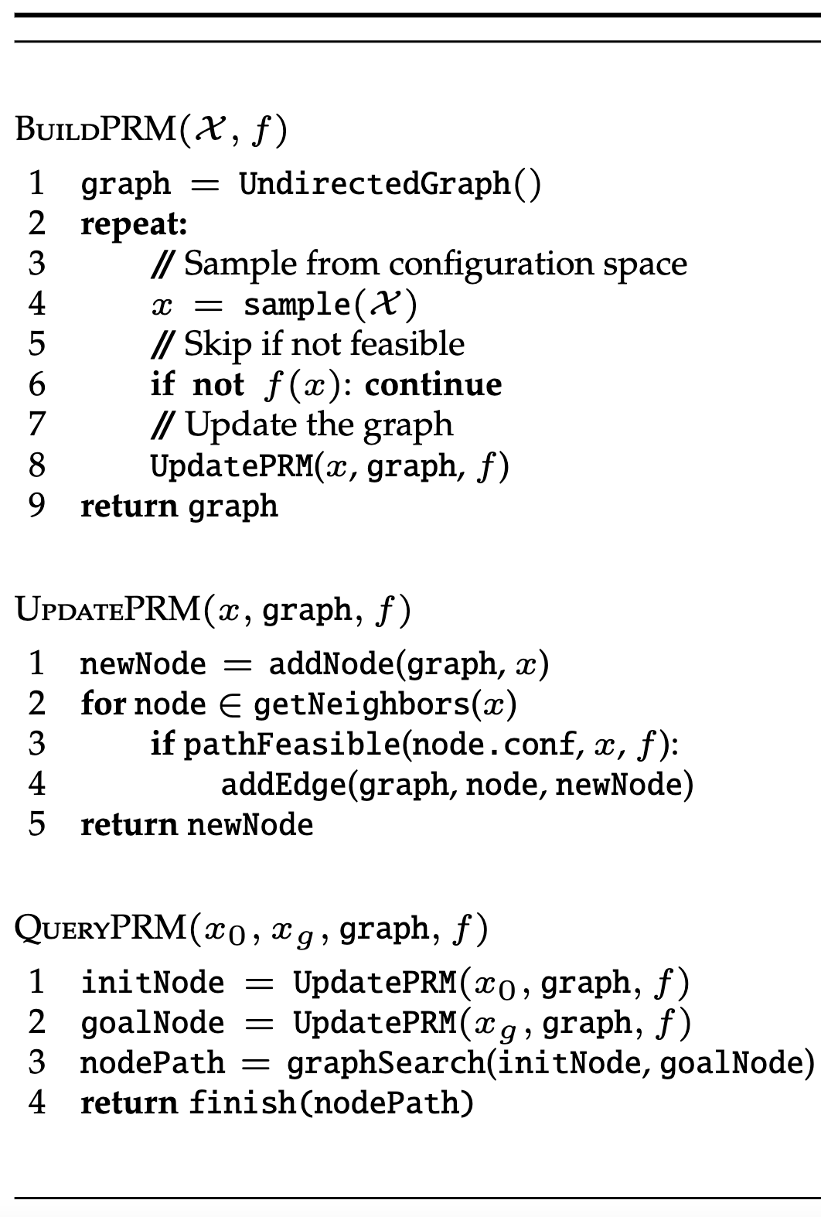
Probabilistic Roadmaps (PRMs)

Slide 72
1.05
0.65
0.55
1.05
0.95
0.45
1.00
0.80
1.25
1.05
1.25
1.15
0.65
0.95
1.05
1.25

Slide 73
1.05
0.65
0.55
1.05
0.95
0.45
1.00
0.80
1.25
1.05
1.25
1.15
0.65
0.95
1.05
1.25

Slide 74
1.05
0.65
0.55
1.05
0.95
0.45
1.00
0.80
1.25
1.05
1.25
1.15
0.65
0.95
1.05
1.25

Slide 75
1.05
0.65
0.55
1.05
0.95
0.45
1.00
1.00
0.70
0.80
Reuse graph for new query
1.25
1.05
1.25
1.15
0.65
0.95
1.05
1.25

Slide 76
1.05
0.65
0.55
1.05
0.95
0.45
1.00
1.00
0.70
0.80
Reuse graph for new query
1.25
1.05
1.25
1.15
0.65
0.95
1.05
1.25

Slide 77
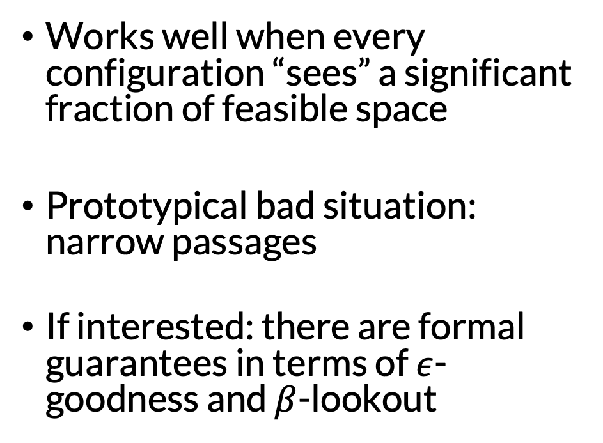
When and Why Does Sampling-Based Motion Planning Work?
Works well when every configuration “sees” a significant fraction of feasible space
Prototypical bad situation: narrow passages
If interested: there are formal guarantees in terms of $ε$-goodness and $β$-lookout

Slide 78
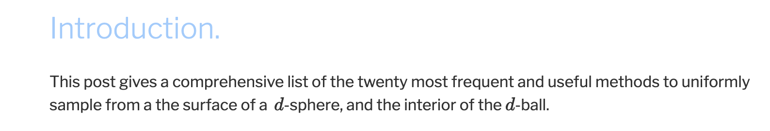
Implementation Considerations
Need to be careful depending on configuration space
Sampling
Example: Sampling uniformly on a sphere requires some thought
https://extremelearning.com.au/how-to-generate-uniformly-random-points-on-n-spheres-and-n-balls/

Slide 79
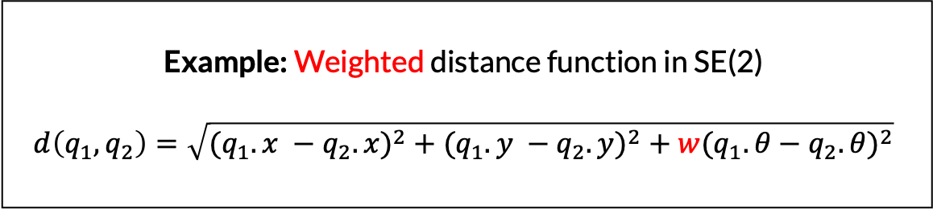
Implementation Considerations
Sampling
Distance metrics
Need to be careful when angles are involved
Example: Weighted distance function in SE(2)
$$d\left(q_{1}, q_{2}\right)=\sqrt{{{(q}_{1}.x −q_{2}.x)}^{2}+{{(q}_{1}.y −q_{2}.y)}^{2}+{{w(q}_{1}. θ−q_{2}.θ)}^{2}}$$

Slide 80
Implementation Considerations
Sampling
Distance metrics
Nearest neighbors
Can often do better than naïve quadratic algorithm
Example: KD trees (for Euclidean configuration spaces)

Slide 81
Implementation Considerations
Sampling
Distance metrics
Nearest neighbors
Collision checking
Usually the speed bottleneck. Use existing optimized libraries!

Slide 82
Implementation Considerations
Sampling
Distance metrics
Nearest neighbors
Collision checking
Interpolation
Linear, polynomial, trapezoidal…

